Slide 1
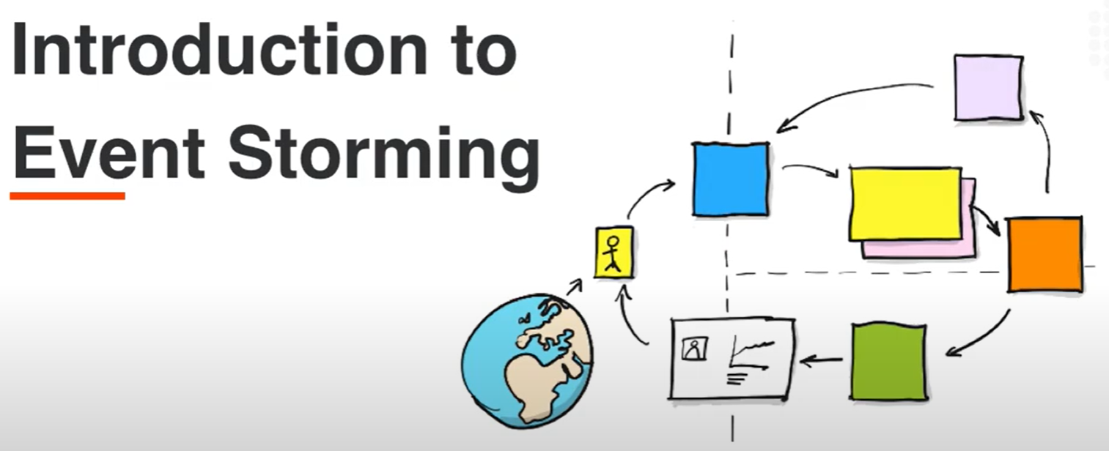

Slide 2
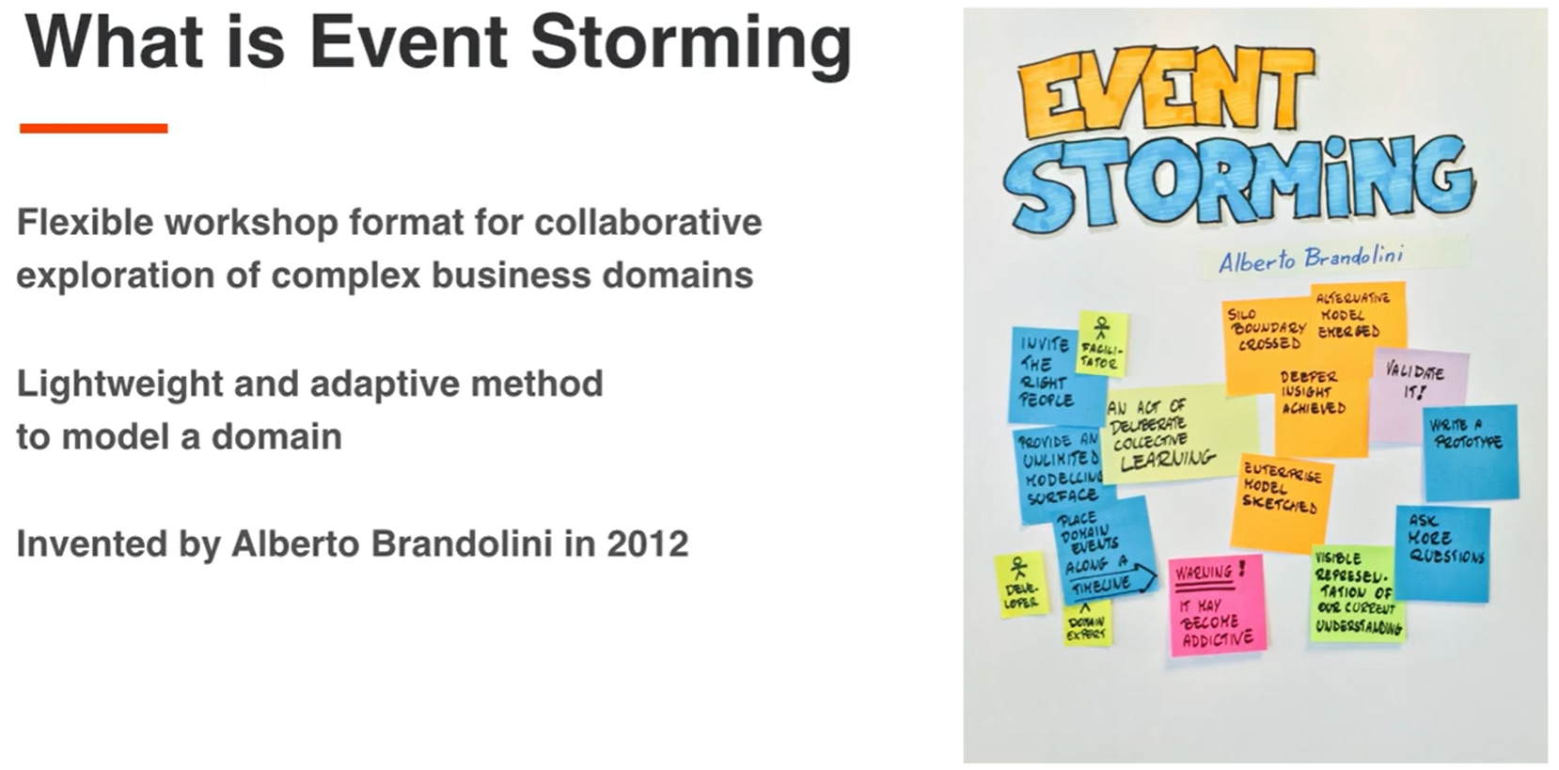

Slide 3
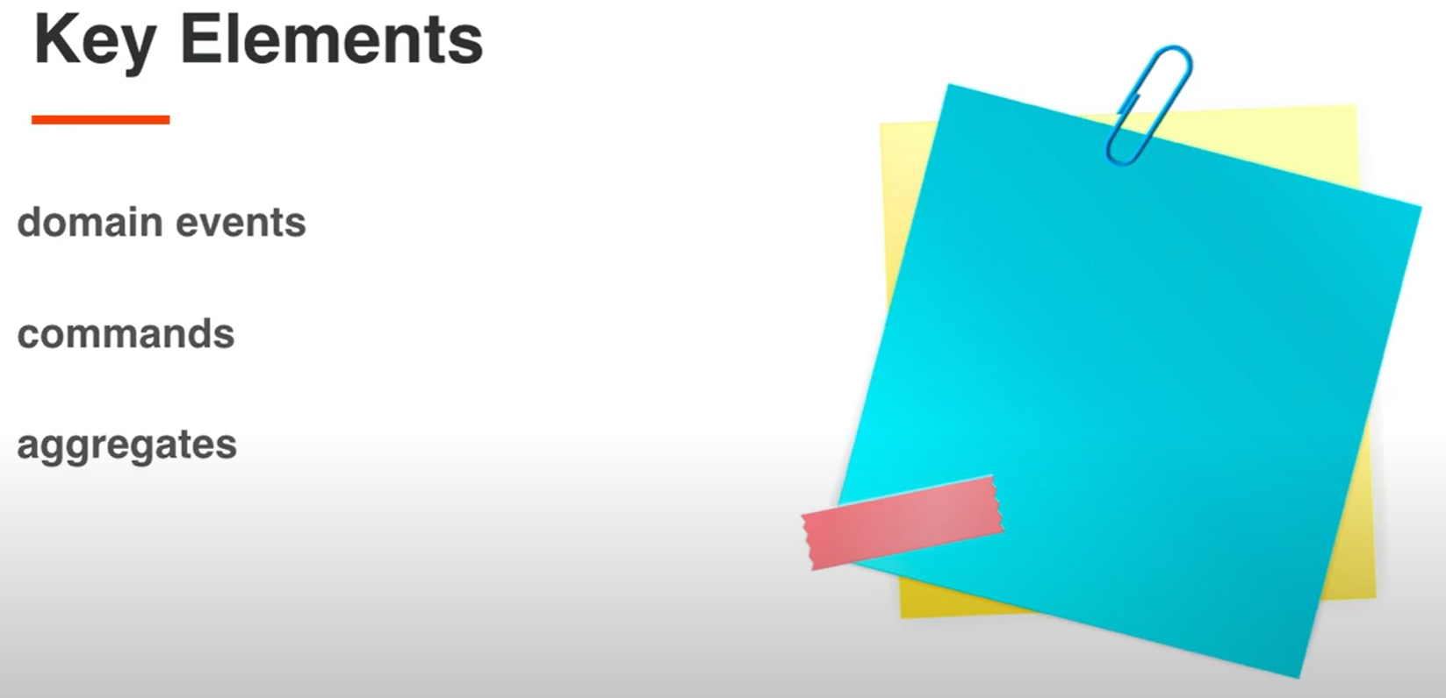

Slide 4
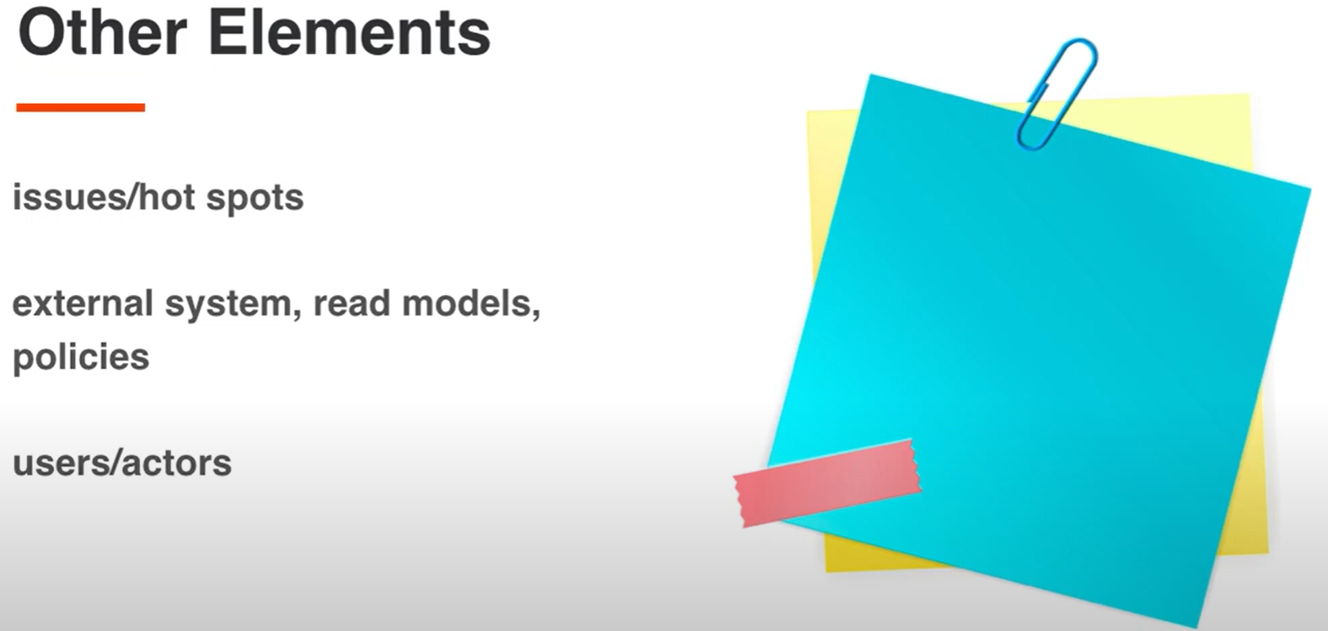

Slide 5
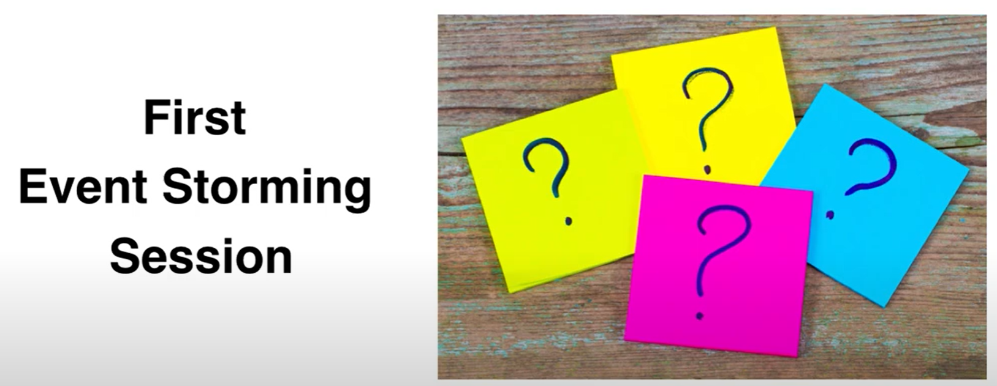

Slide 6


Slide 7


Slide 8


Slide 9


Slide 10
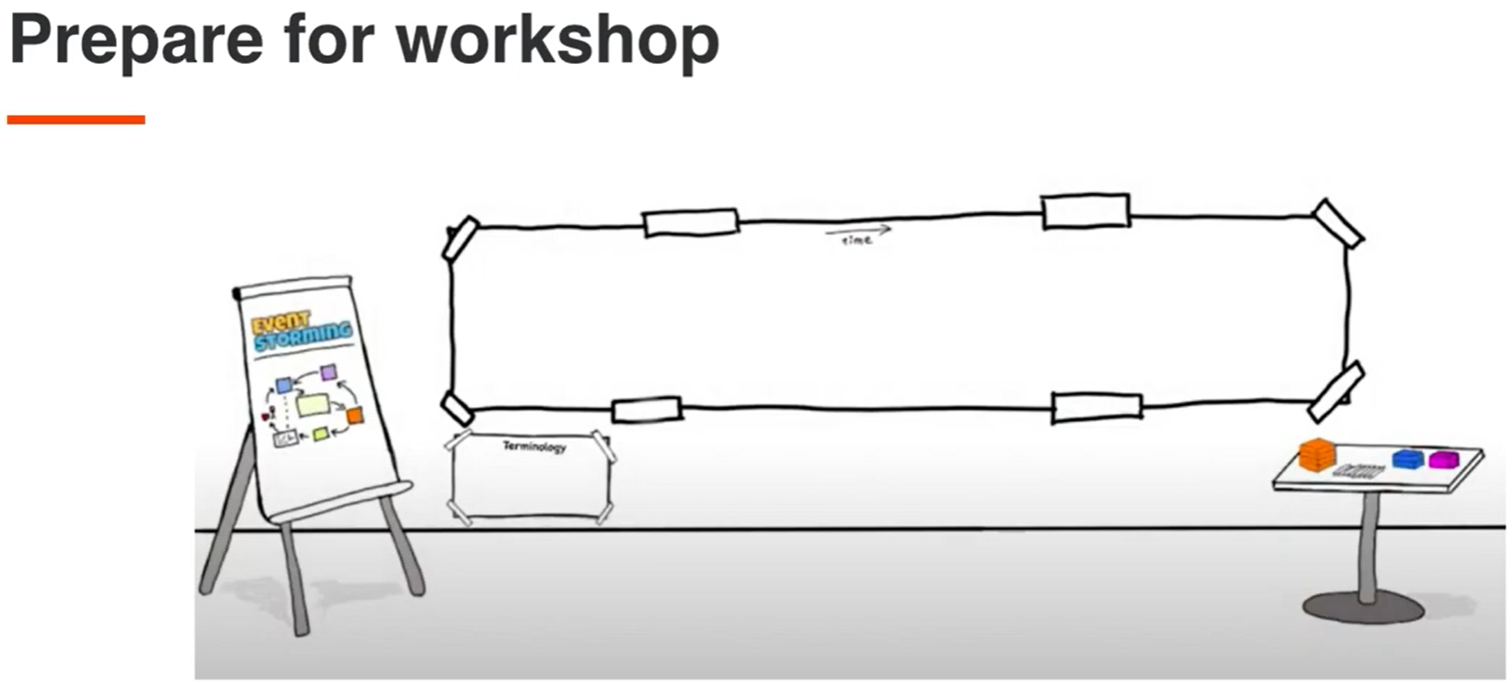

Slide 11
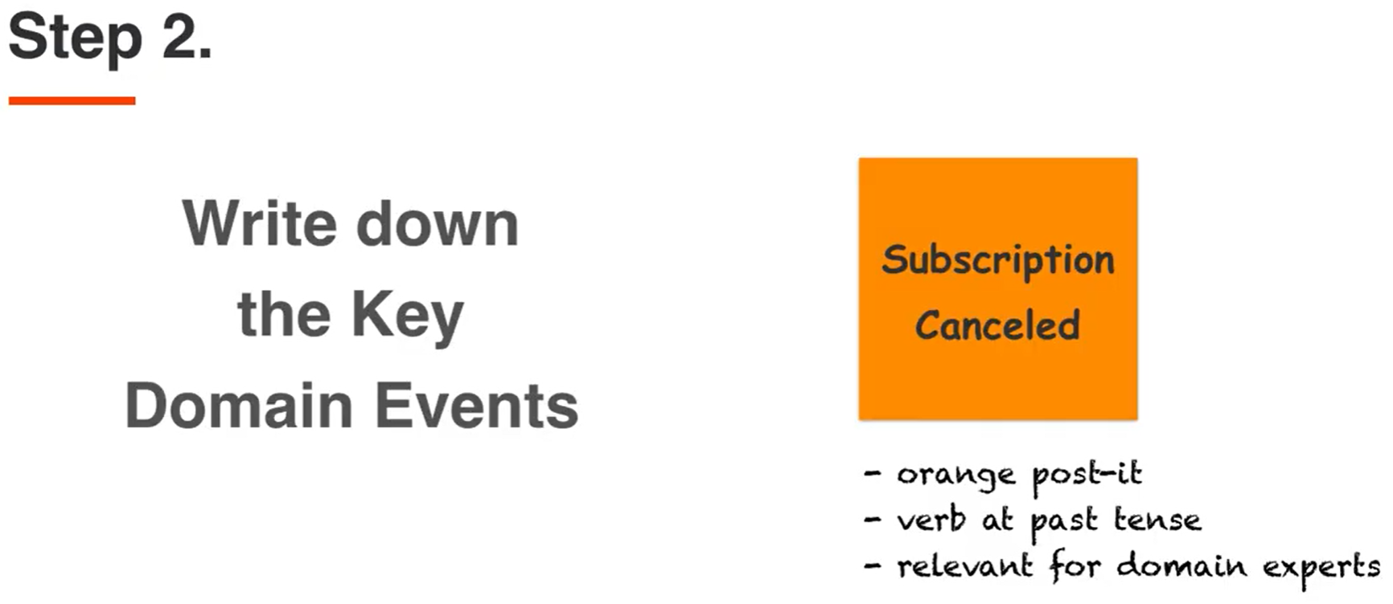

Slide 12
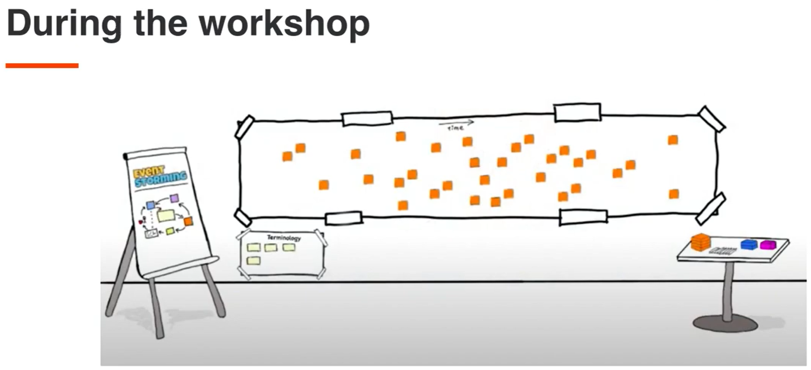

Slide 13
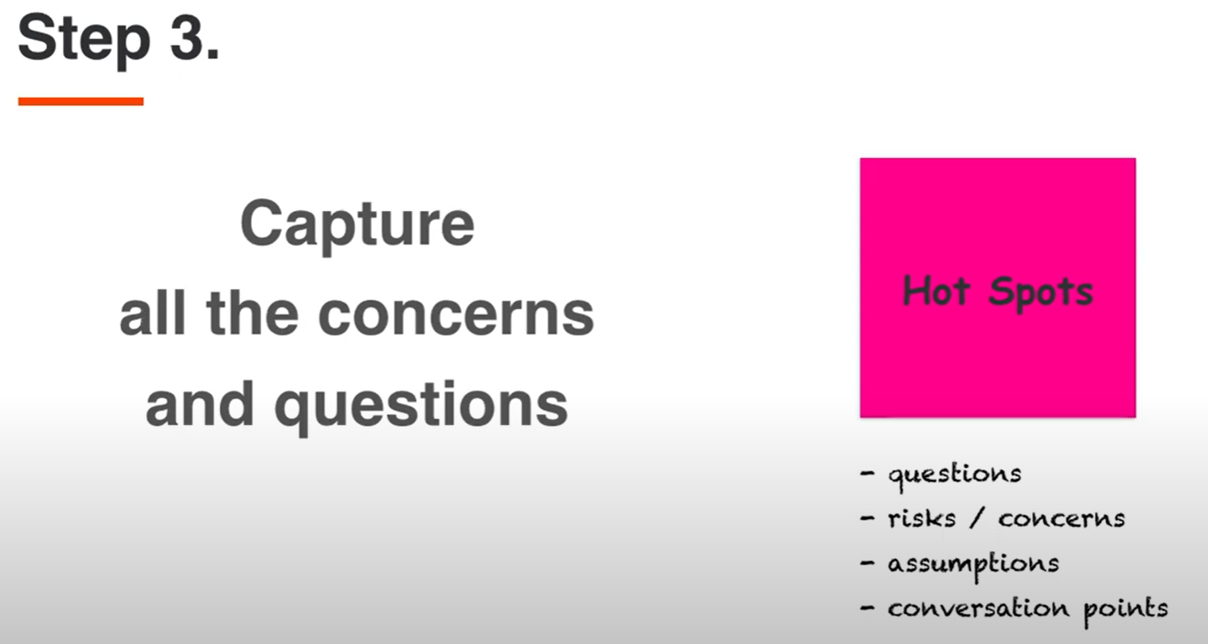

Slide 14
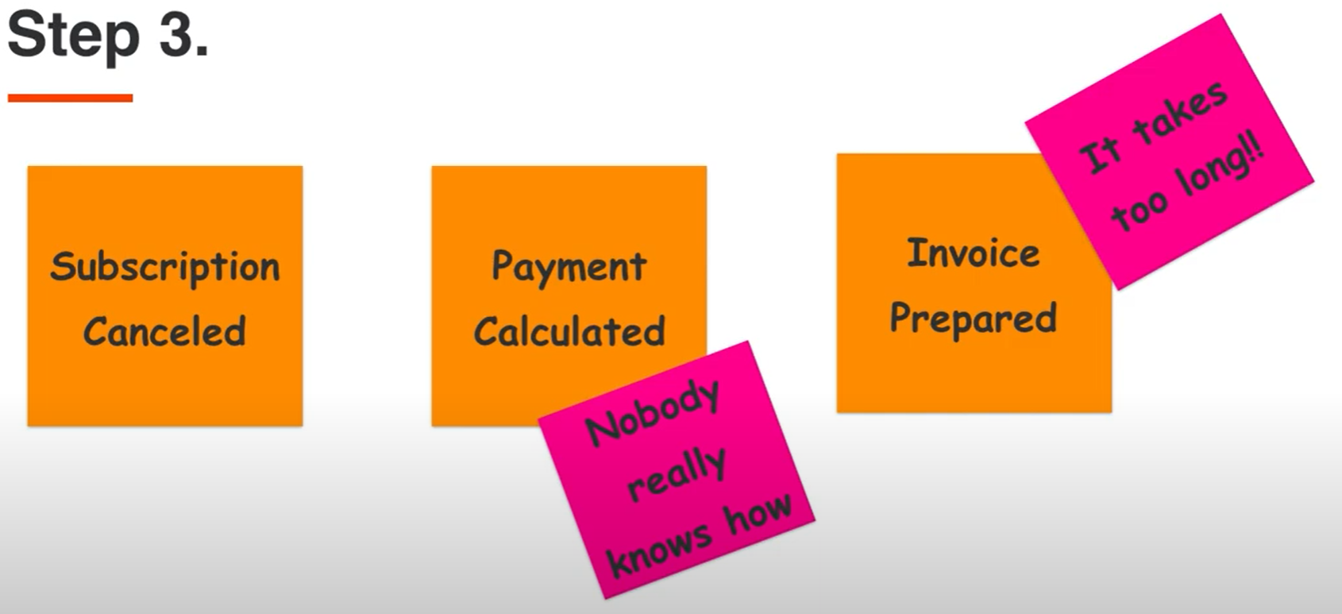

Slide 15
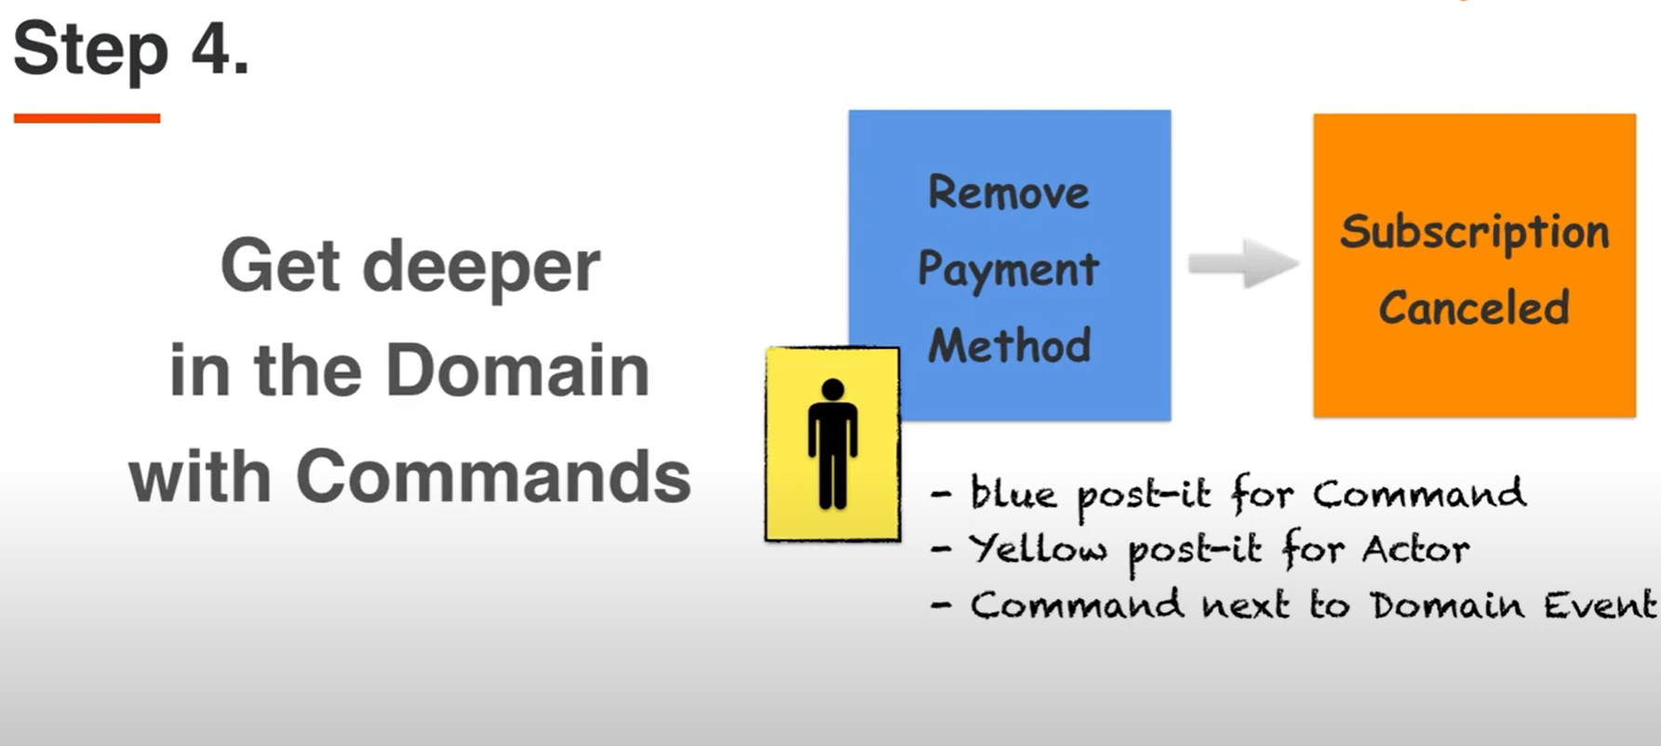

Slide 16
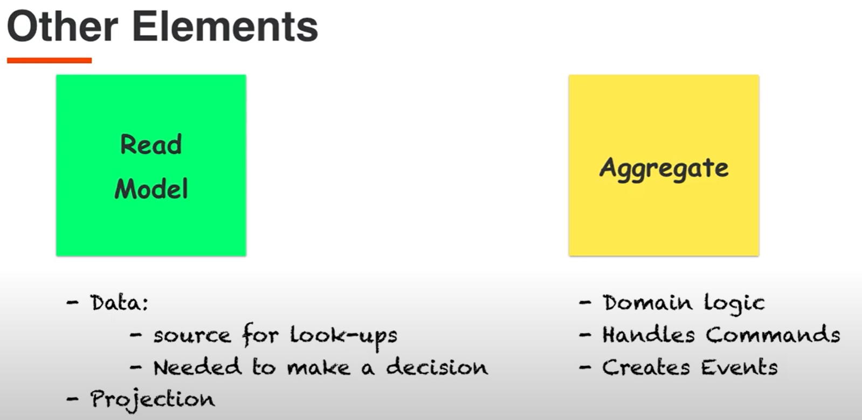

Slide 17
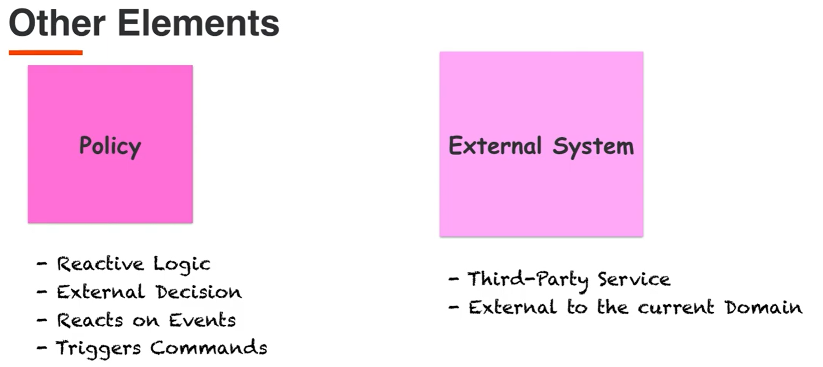
Notes:
https://github.com/kgrzybek/modular-monolith-with-ddd/issues/38
https://github.com/kgrzybek/modular-monolith-with-ddd
What are policies in event storming?
In essence, a policy is a reaction that says “whenever X happens, we do Y”. Eventually ending up with in the flow between a Domain Event and a Command/action. We use a big lilac post-it for these. A policy can be an automated process or manual.

Slide 18
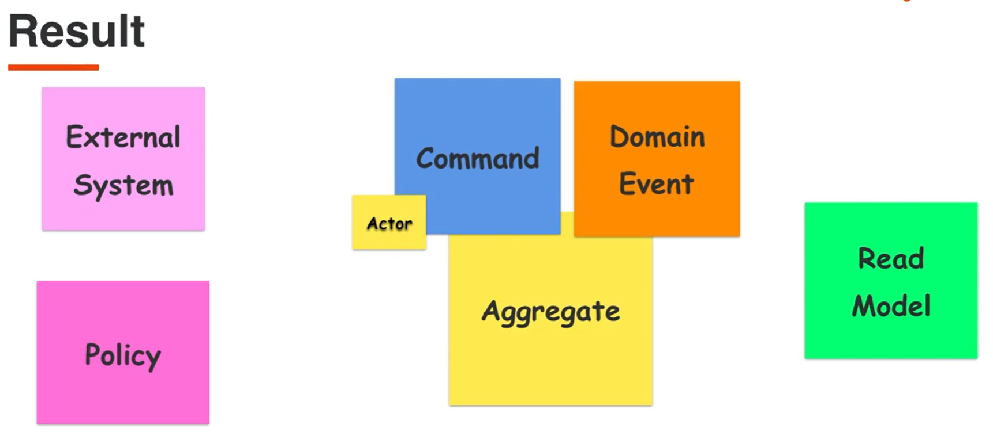

Slide 19
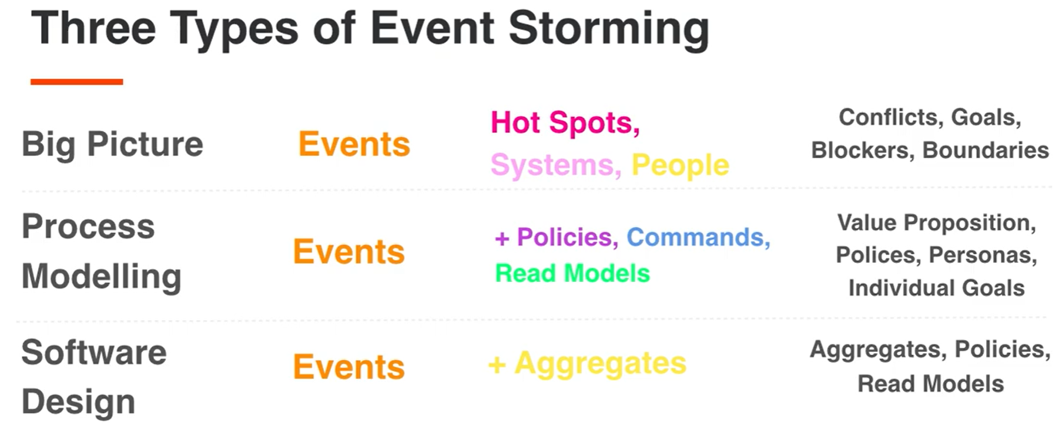

Slide 20


Slide 21
